Slide 1
Developmental Education in Utah: Where We Are and What We Know
Utah System of Higher Education, Office of Institutional Research
Dr. David Ma, Longitudinal Studies Manager
Charles Steimel, Research Analyst
Laura Zemp, Research Analyst

Slide 2
Overview
Institutional policies for placement in remedial courses throughout USHE
Comparisons of remedial course takers and other students by demographics, course-taking patterns, ACT, and GPA.
USHE Math Study – Longitudinal study of 2008 entering cohort looking at math remediation and graduation.

Slide 3
Is it Remedial or Developmental?

Slide 4
Math and English Placement Policies – Institutions Vary
Policies change - Summer 2014, some updates
Differences within and among institutions
How long placement is valid
Accuplacer scores to be eligible to take a course
Acceptable course grades to move on
How students begin the placement process
What type of courses are available (concurrently, subject)
Why this matters
Student success in courses
Transfer

Slide 5
What do math policies look like amongst institutions?
Placement policy – Mandatory everywhere but challenge at UU
Institution | Accuplacer Branching | Accuplacer | ACT | Course
UU | Start with EA | 2 years | 2 years | No Limit
USU | Choose EA or CLM (Most CLM) | 1 year | 1 year | 1 year
WSU | N/A | 1 year | 2 years | 1 year
SUU | Start with EA; 0-39 go to AR, 90+ go to CLM | 2 years | 2 years | 2 years
SNOW | Meet with students; default EA | 2 years | 2 years | 2 years
DSU | Start with AR | 2 years | 2 years | 2 years
UVU | Start with EA | 2 years | 2 years | 2 years
SLCC | Start with EA | 1 year | 1 year | 1 year
Placement policy data from Summer 2014

Slide 6
Placement Scores for College Level Math Courses ACT Scores
ACT Cut Scores
23 for Math 1050 College Algebra and Math/Stat 1040 Intro to Statistics/Math 1030 Quantitative Reasoning
SLCC also requires a 20 in Reading on the ACT
Course prerequisites require C or better to move to next course
Placement policy data from Summer 2014

Slide 7
Placement Scores for College Level Math Courses Accuplacer Scores and Prerequisite Courses
Institution | 1050 | 1040 | 1030
UU | CLM > 60; Math 1010 | CLM > 50; Math 1010 or other QL | CLM > 50; Math 1010
USU | CLM 60-79; Math 0995 or 1010 | EA > 80 or CLM > 45; Math 1010 | CLM > 50; Math 1010
WSU | CLM 50-69; Math 1010 | CLM 50-69; Math 1010 or other QL | CLM 50-69; Math 1010
SUU | CLM 50-89; Math 1010 | CLM 50-89; Math 1010 | CLM 50-89; Math 1010
SNOW | EA > 90 or CLM 50-69; Math 1010 | EA > 90 or CLM 50-69; Math 1010 | EA > 90 or CLM 50-69; Math 1010
DSU | EA 89-94; Math 1010 or 1000 | EA 89-94; Math 1010 or 1000 | EA 89-94; Math 1010 or 1000
UVU | CLM > 60; MAT 1000 or MAT 1010 | CLM > 60; MAT 1000 or MAT 1010 | CLM > 60; MAT 1000 or MAT 1010
SLCC | CLM > 43 and Reading > 71; MATH 1010 | CLM > 43 and Reading > 71; MATH 1010 | CLM > 43 and Reading > 71; MATH 1010
Placement policy data from Summer 2014

Slide 8
Placement Scores for Remedial Math Courses
Institution | 1010 | 990 | 950
UU | EA 54-89 or EA 90+ and 0-49 CLM; ACT 18; Math 0990 (C-) | AR < 120 or EA 0-54; ACT 14-17 | N/A
USU | EA 58-99 or CLM 40-49; ACT 18 and placement test; Math 0990 (C-) | EA 40-57; Math 950 (C-) | EA 0-39; ACT 11-16 USU Eastern Only
WSU | Rubric of HS GPA & ACT; Math 0990 (C) | EA > 81 | AR 0-74
SUU | EA 55-89 or CLM 0-49; ACT 18; Math 0990 (B-) | AR > 65 or EA 40-54; ACT 14-17; Math 0950 (B-) | AR 0-64
SNOW | AR 100+ or EA 55-89 or CLM 35-49; ACT 18; Math 0990 or 0970 (C) | ACT 15-17 | AR 0-99 or EA 0-54; ACT 0-14
DSU | EA 54-88; ACT 18; Math 0990 (C) | AR 31-74 or EA 29-53; ACT 13-17; Math 0900 (C) | AR 0-30 or EA 0-28; ACT 0-12
UVU | EA > 61 or CLM 30-59; ACT 19; MAT 0990 or 0980 (C) | AR > 90 or EA 46-60; ACT 17-18; MAT 0950 or 0980 (C-) | Appropriate Accuplacer; ACT 16; MAT 0920 (C-)
SLCC | EA 54-89 or CLM 0-42; ACT 18; Math 0990 or 0970 (C) | AR > 75 and EA 40-53; ACT 15-17 | AR 35-74
Placement policy data from Summer 2014

Slide 9
What do English policies look like amongst institutions?
Placement policy – Mandatory everywhere but challenge at UU
Institution | Accuplacer | ACT | Course
UU |  |  | No Limit
USU | No Limit | No Limit | No Limit
WSU | 1 year | No Limit | No Limit
SUU | No Limit | No Limit | No Limit
SNOW | No Limit | No Limit | No Limit
DSU | No Limit | No Limit | No Limit
UVU | 3 years | 3 years | No Limit
SLCC | 2 years | 2 years | No Limit
Placement policy data from Summer 2014

Slide 10
Placement Scores for College Level English Courses
Institution | 2010 | 1010
UU | Index Score > 96; Placement Essay; WRTG 1010 (C-) | Index Score < 95
USU | ACT 29; AP English > 3; ENGL 1010 (D) | Default placement; Diagnostic first day to place into ENGL 0010
WSU | ACT 29 (English and Reading); ENGL 1010 (C) | ACT 17; RC > 90 and SS > 90; ENGL 0995 (C)
SUU | ACT 29; ENGL 1010 (C) | ACT 17; ACT < 17 must take ENGL 1000 concurrently
SNOW | ACT > 29 and writing exam; ENGL 1010 (C-) | ACT 17; Writing Exam; ENGL 0980 or 0990
DSU | AP English > 3; ENGL 1010 (C) and LIB 1010 | RC > 66 AND SS > 86 or ACT 19 English/17 Reading for 1010 ; RC > 66 AND SS > 70-85 or ACT 18 English/17 Reading for 1010D; ENGL 990 (C)
UVU | No Test in Option; ENGL 1010 (C-) | ACT 19; CTRS 1170 (C-) and ENGL 0990 (C-)
SLCC | No Test in Option; ENGL 1010 (C) | RC > 81 and SS > 80; ACT 20
Placement policy data from Summer 2014

Slide 11
Placement Scores for Remedial English Courses
Institution | Writing | Reading
UU | N/A | N/A
USU | ENGL 0010 - Placement 1st day of ENGL 1010; USU Eastern ENGL 0990 14-16 ACT, RC > 60 or SS 0-69 | N/A
WSU | ENGL 0955 RC or SS 40-89; ACT 13-16 English and Reading; ENGL 0900 RC or SS 0-39; ACT 0-12 English or Reading
SUU | ENGL 1000 ACT < 17; taken concurrently with ENGL 1010 | N/A
SNOW | ENGL 0980 ACT < 17 | N/A
DSU | ENGL 1005 (Students in ENGL 1010D take concurrently) – ACT < 16; ENGL 0990 SS 70-86; ACT 16-18 | ENGL 1470 ACT > 12; RC 42-65; ENGL 0470 (C) ENGL 0470 ACT 0-11; RC 1-41
UVU | ENGL 0990 COMPASS Writing and DRP > 77; ENGL 0890 (C-) | CTRS 1170 – DRP 70-76 CTRS 0900 – DRP 58-69; CRTS 0800 (C-) CTRS 0800 – DRP 50-57
SLCC | WRTG 0990 with ENGL 0995 Lab RC 59-80; ACT 16-19 WRTG 0900 RC 40-59; ACT 14-15 | LE 1260 RC 71-80 RDG 0990 RC 55-70 RDG 0900 RC 30-57
Placement policy data from Summer 2014

Slide 12
USHE Remedial Rates over the Past 10 Years

Slide 13
USHE Remedial Rates by Subject

Slide 14
Math 1010 - The Difference One Course Can Make

Slide 15
Remediation by Gender

Slide 16
Remediation by Ethnicity

Slide 17
Remediation by Age

Slide 18
Remediation by ACT

Slide 19
Remediation by Institution

Slide 20
Outcomes: 1st-Year Academic Performance

Slide 21
The Case of Math Remediation
What happens to a cohort over time?

Slide 22
Initial Research Questions
Proportion of students who completed math requirement in their first year
Number of remedial math classes prior to completing the math requirement

Slide 23
Utah’s SLDS
Utah Data Alliance
Four Data Providers
Technical Partner
Research Partner
Additional Data Source
K-12 education (Utah State Office of Education)
Higher education (USHE)
Technical College system (Utah College of Applied Technology)
Workforce (Department of Workforce Services)
Utah Education and Telehealth Network
Utah Education Policy Center
National Student Clearinghouse

Slide 24
Participant Descriptives
First-time students within 12 months of high school graduation (FH)
Entered a USHE school in 2008-2012 academic years
Race | Count (%)
American Indian | 877 (1.1%)
Asian | 2,136 (2.6%)
Black, Non-Hispanic | 1,151 (1.4%)
Hispanic or Latino | 6,241 (7.7%)
White | 66,988 (82.7%)
Two or More Races | 360 (.4%)
Hawaiian or Pacific Islander | 1,050 (1.3%
Unknown | 2,219 (2.7%)

Slide 25
Earning Math Credit Variable
Two Options
Earned in concurrent enrollment or through AP test in high school
Limitation: only available for students in the set who graduated from a Utah high school (70.5% of students)
Passed a college-level math (CLM) class
Defined ‘within one year’ as 4 terms (Fall, Spring, Summer, & Fall) including initial enrollment.
C- counts for a pass
Took a remedial course prior to passing CLM

Slide 26
FH Students First Year of College Math Enrollment Breakdown

Slide 27
Number of Remedial Courses FH Students who Earned CLM Credit Took

Slide 28
Remedial Courses FH Students who have not earned CLM credit took

Slide 29
Initial Key Findings
About 43% of FH students are earning their CLM credit by the end of their first year
14% Concurrent Enrollment
5% by AP/ACT
23% Passing course
Students are successfully taking a remedial course and going on to earn their CLM credit
Students who take a math class their first year are much more likely to eventually earn CLM credit
19% of students never take math despite needing the CLM credit

Slide 30
But that was just a beginning….

Slide 31
FH 2008 Student Outcomes by Math Enrollment

Slide 34
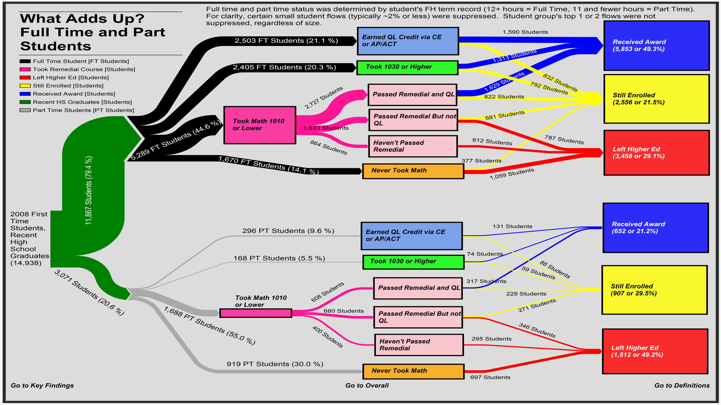

Slide 36
Non-Traditional Students Passing a CLM Course by First Year Math Enrollment after 5 years after Enrollment

Slide 37
QUESTIONS?

Slide 38
What’s next
Our ideas
Other Suggestions
Success in remedial and CLM course delay
HS graduates course taking by SES
Common Core impact – What has changed? What hasn’t?

Slide 39
Data for this research was accessible through Utah’s state longitudinal data system database administered by the Utah Data Alliance (UDA) which includes data supplied by UDA partners and the StudentTracker service from the National Student Clearinghouse. This research including the methods, results, and conclusions neither necessarily reflect the views nor are endorsed by the UDA partners. All errors are the responsibility of the author. For more information please visit www.UtahDataAlliance.org.

